Slide 1
Fuzzing and Symbolic Execution
05_angr_symbolic_memory 06_angr_symbolic_dynamic_memory 07_angr_symbolic_file
Presenter: Sukyeong Bang
Notes:
95-114

Slide 2
Previous
int main(int argc, char* argv[]) {
uint32_t user_int0;
uint32_t user_int1;
scanf("%u %u", &user_int0, &user_int1);
...
if ((user_int0 ^ USERDEF0) || (user_int1 ^ USERDEF1)) {
printf("Try again.\n");
} else {
printf("Good Job.\n");
}
}
Processes ‘user_input’ and compares it with ‘USERDEF’ to trigger "Good Job"
Uses angr to explore execution paths and calculate the specific input required to reach the "Good Job" state
Injects symbols for variables stored in Stack, Register or Heap

Slide 3
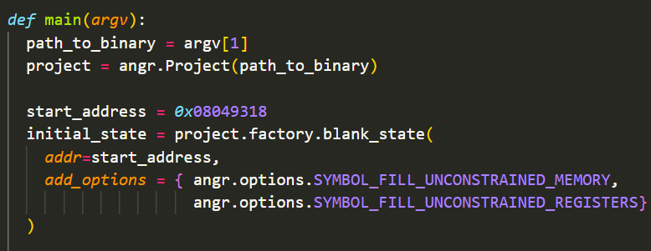
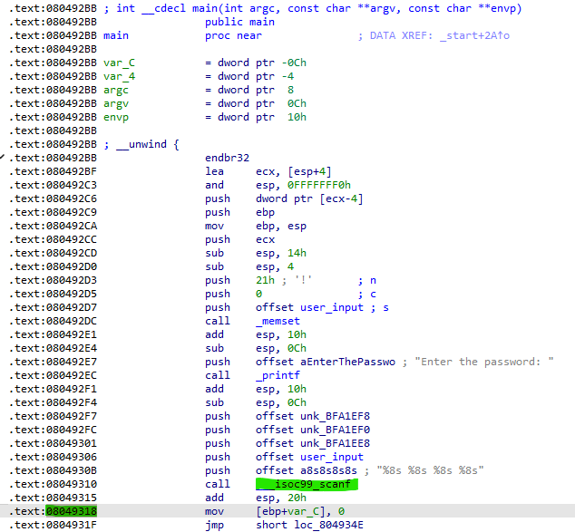
05_angr_symbolic_memory
Symbolic Execution in Global Memory
start_address: 0x08049318

Slide 4
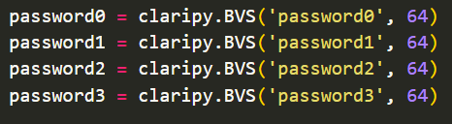
05_angr_symbolic_memory
Symbolic Execution in Global Memory
“%8s %8s %8s %8s”

Slide 5
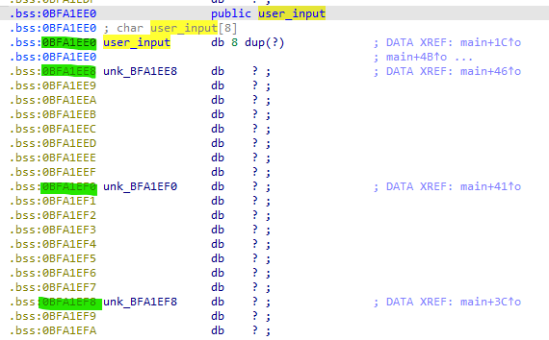
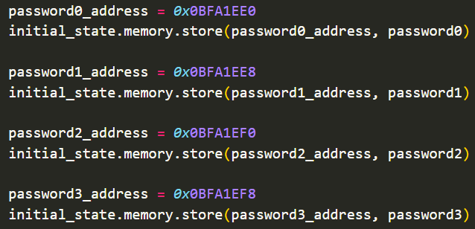
05_angr_symbolic_memory
Symbolic Execution in Global Memory
User_input

Slide 6
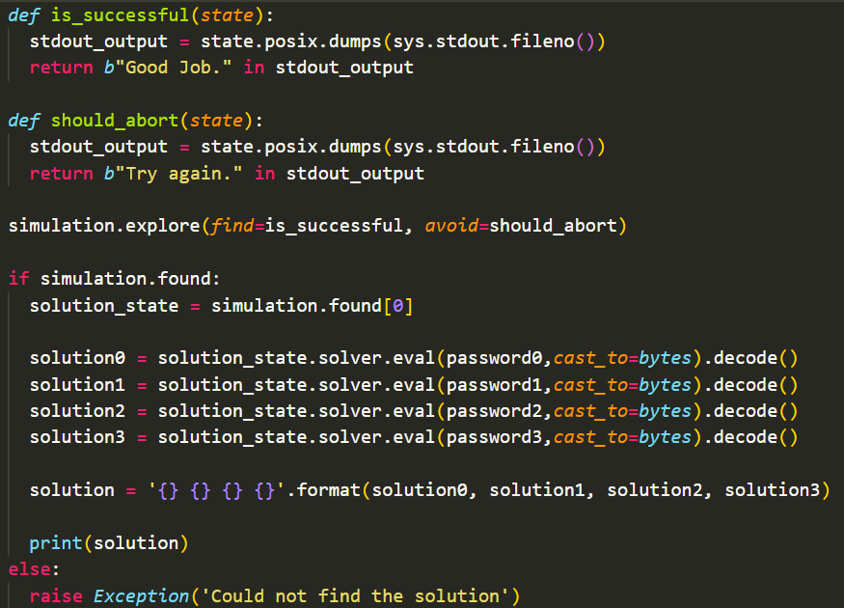
05_angr_symbolic_memory
Symbolic Execution in Global Memory
Initiates the search for the optimal execution path by defining target addresses to reach (find) and to bypass (avoid)
If a solution is found, solve the accumulated constraints to determine the valid input

Slide 7
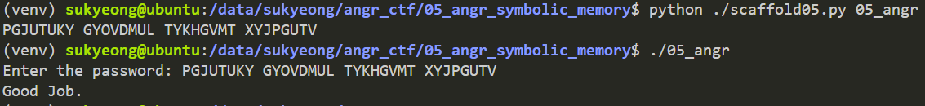

05_angr_symbolic_memory
Symbolic Execution in Global Memory

Slide 8
06_angr_symbolic_dynamic_memory
Dynamic memory is allocated on the heap, where addresses are subject to change with every execution
However, the pointer variable that stores the heap address is located at a fixed address
How to conduct symbolic execution in memory
Register | Stack | Global Memory | Heap
Register | Register + Offset | Fixed Address | Pointer Address → Fake Pointer Address

Slide 9


06_angr_symbolic_dynamic_memory
Symbolic Execution in Dynamic Memory
start_address: 0x0804938F

Slide 10
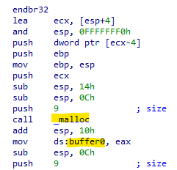
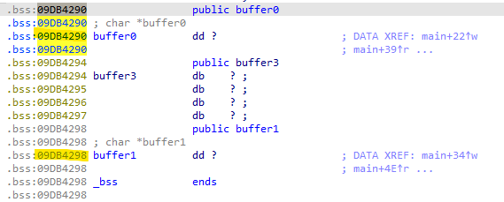
06_angr_symbolic_dynamic_memory
Symbolic Execution in Dynamic Memory
Pointer address

Slide 11
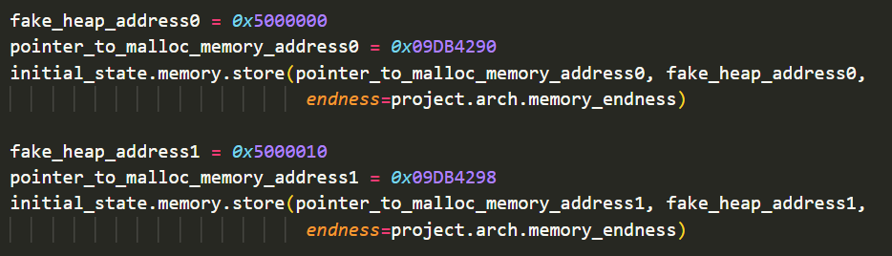

06_angr_symbolic_dynamic_memory
Symbolic Execution in Dynamic Memory
Pointer address

Slide 12
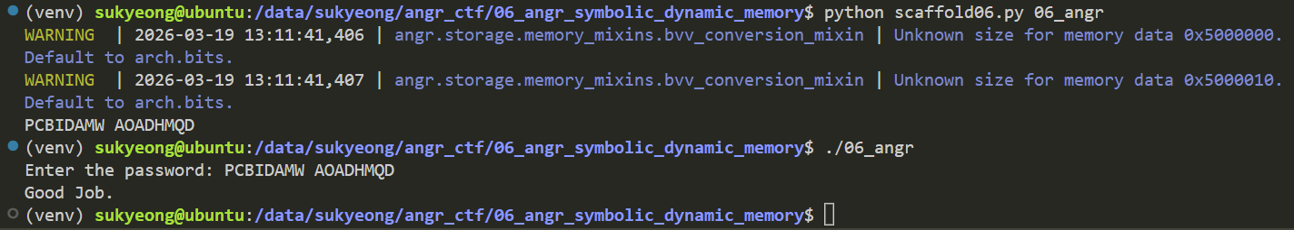
06_angr_symbolic_dynamic_memory
Symbolic Execution in Dynamic Memory

Slide 13
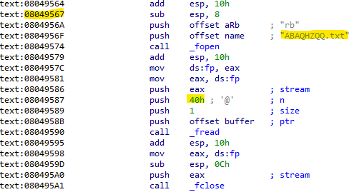


07_angr_symbolic_file
Treating Files (linux file, txt file, program, etc) as Symbolic Memory Regions
Symbolic Execution in file
Start address: 0x08049567

Slide 14

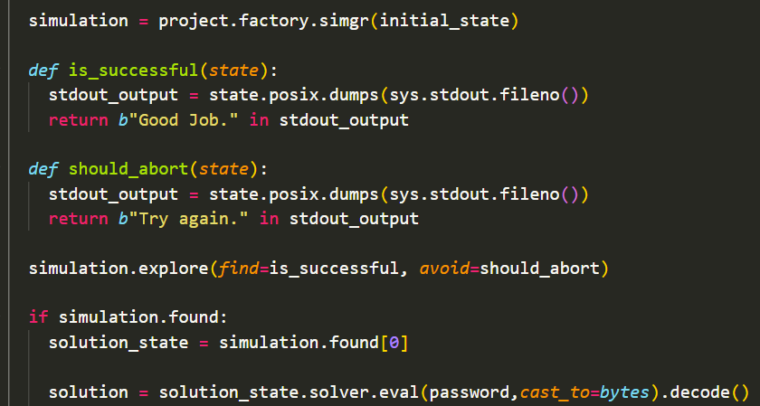
07_angr_symbolic_file
Symbolic Execution in file
Define a symbolic bitvector for the file's contents
Set its contents to symbolic data

Slide 15
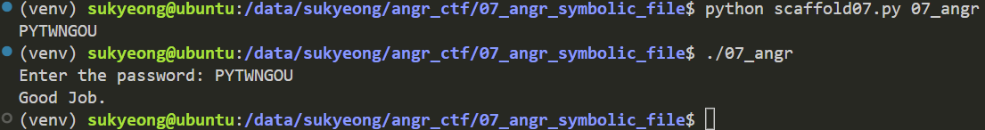
07_angr_symbolic_file
Symbolic Execution in file

Slide 16
Practice
Detecting Hardcoded Backdoors via Symbolic Execution
Adversary: Malicious internal developer
Inputting the secret Key grants immediate system shell access

Slide 17
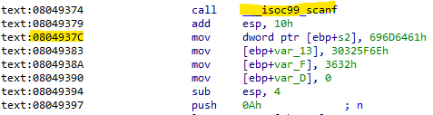

Practice
Find the Start address and input address

Slide 18
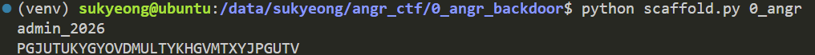
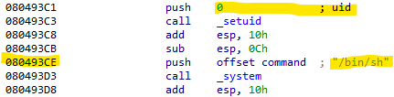
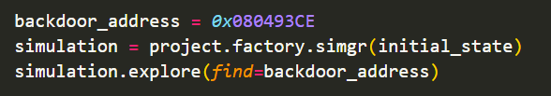
Practice
(1) Find the function
simulation.explore(find=is_successful, avoid=should_abort, num_find=3)
(2) Find the command

Slide 19
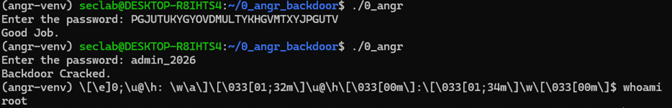
Practice
Authentication Bypass & Privilege Escalation

